Slide 1
Analysis of How International Environmental Policies Impact Pollution & Biodiversity
Stacy Marshall, Delphine Albrecht and Ghazi Muhammad

Slide 2
Motivation and Summary
Define the core message or hypothesis of your project
Our focus was on the relationships between between pollution and the environment and how that impacts biodiversity on an international scale.
The OECD (Organisation for Economic Co-operation and Development) and WWF (World Wildlife Fund) proved to be great resources for this type of data
We chose to define our question based on the available data :
“ How much does the environmental policy of a country impact on
its CO2 production, pollution and biodiversity? ”
Describe whether you were able to answer these questions to your satisfaction, and briefly summarize your findings
We sourced a large amount of data that enabled us to partially answer our question in the allotted time, and would allow a lot of room for further exploration in the future:
A high stringency on environmental laws is generally correlated with a decrease in CO2 emission.
A high stringency on environmental laws is correlated with a decrease in the mean population exposure to fine particles.

Slide 3
Questions & Data
“ How much does the environmental policy of a country impact on
its CO2 production, pollution or biodiversity? ”
Where did we find the Data ?

Slide 4
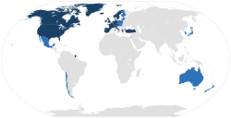
Collection of the datasets used in this project
Organisation for Economic Co-operation and Development
Created in 1961 by 18 European countries, the US and Canada
Created to promote policies that will improve the economic and social well-being of people
Today, 36 member countries span the globe, from North and South America to Europe and Asia-Pacific.
Data covers a large number of topics ranging from agriculture to Education, Energy, Environment, Finance, Health, and more!
Open access
Founding member countries (1961)
Other member countries

Slide 5
Wealth of Information

Slide 6
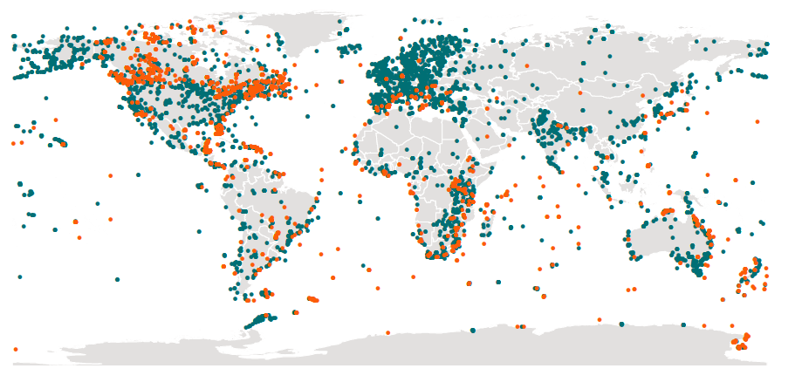
Collection of the datasets used in this project
World Wildlife Fund (WWF)
Created in 1961, WWF is a non-governmental organization
Created to work in the field of the wilderness preservation, and the reduction of human impact on the environment
The world's largest conservation organization with over five million supporters worldwide, working in more than 100 countries
Collaboration with OECD
Open access data
Data collection points (the most recent are in orange)

Slide 7
Biodiversity Information Galore

Slide 8
Question at hand: “ How much does the environmental policy of a country impact on its CO2 production, pollution or biodiversity? ”
Elaborate on the questions you asked, describing what kinds of data you needed to answer them, and where you found it
- The OECD database has an incredible amount of data available. For example for Air & Climate, we had access to :
Emissions of air pollutants : Total man-made emissions, Total mobile sources, Total stationary sources, Industrial combustion, Other combustion, Agriculture, Waste, Total emission intensities ...
Each of this categories are available for Sulphur Oxides, Nitrogen Oxides, Particulates (PM10 or PM2.5), Carbon monoxide or Non-methane volatile Organic compounds.
But also the greenhouse gas emission by sources more specifically ...
We had to better understand each category and select relevant datasets. We finally focused on 6 categories:
Mean population exposure to PM2.5 (pollution), Percent of CO2 emission (pollution), GDP per capita (development), Percent of Total Government R&D budget for Environment (government action), Percent of Total tax Revenue for environment (government action) and Environmental policy stringency (government action). We also used the biodiversity data from WWF dataset (biodiversity).

Slide 9
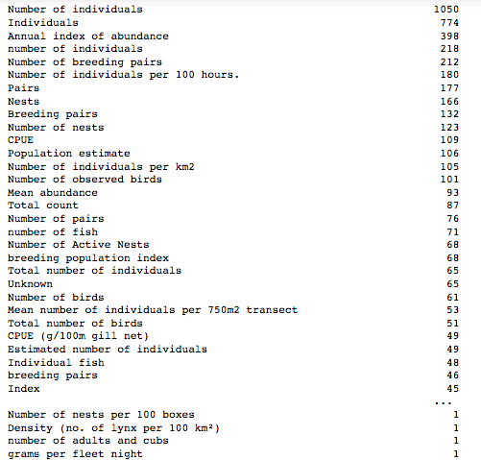
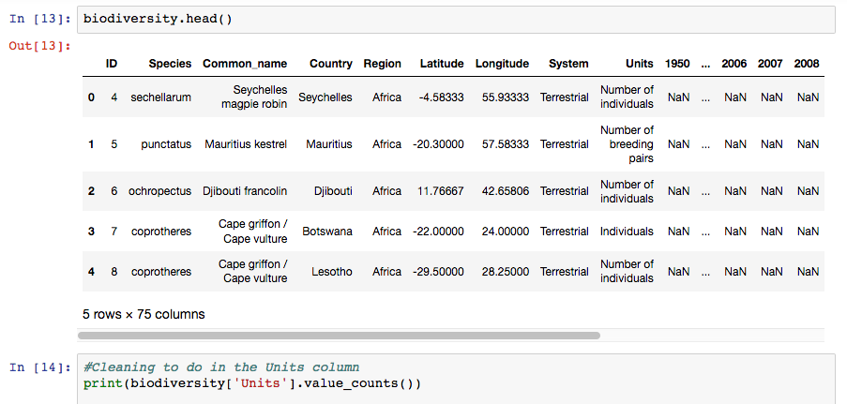
Data clean up and exploration
Describe the exploration and cleanup process, Discuss insights you had while exploring the data that you didn't anticipate, Discuss any problems that arose after exploring the data, and how you resolved them
Our biodiversity dataset was particularly complex as collected from a large number of different countries with a wide variety of collection techniques. We chose to focus on collecting the number of individuals counted.

Slide 10
Data Complexity and Missing Values

Slide 11
Data clean up and exploration
Present and discuss interesting figures developed during exploration
In order to compare different countries outcome, we had to convert a lot of data into percentages.
This revealed to us that while some countries have a decrease of CO2 emission over the past 15 years (Austria, US, UK, France...) some other do not (Canada, Australia...). We found this trend interesting and chose to select 4 countries to further analyze our datasets: Austria, France, US and Canada.

Slide 12
Narrowing Our Focus To Select Countries
These 4 countries appeared to use as particularly interesting to study as all of them had a wide variety of data available.
Moreover, in contrast to the other countries, Canada seems to have a decreased biodiversity since 1974. Is there anything specific to Canada compare to the other countries that could correlate to this observation?
Notes:
Taking two countries in one continent and compare them to each other and to the another continent seemed to us as relevant for our question.

Slide 13
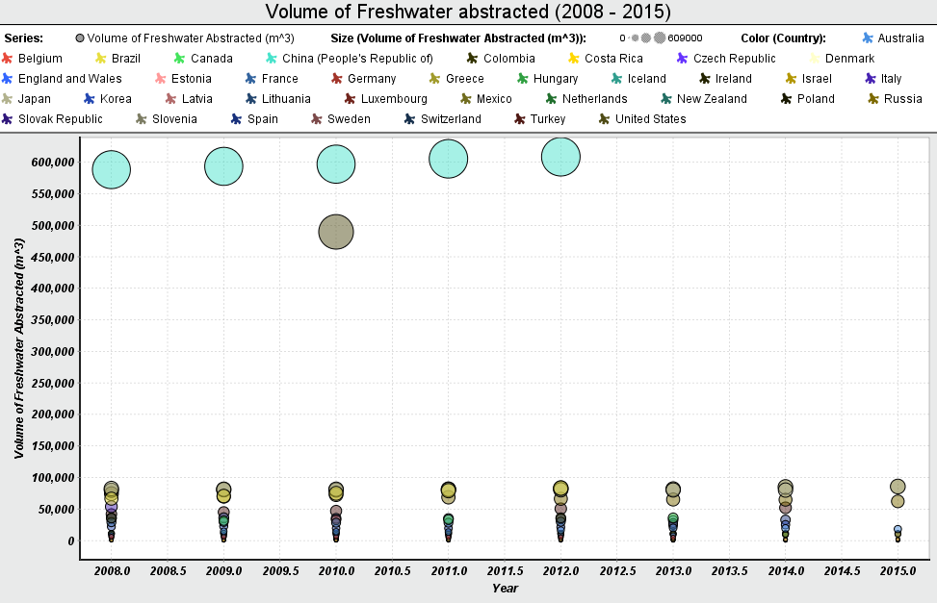
Freshwater pull affect on biodiversity(Fish) )
Logically we expect, as water from oceans, lake, etc, decreases, the population of water species, should decrease.
Out of 36 Countries, China and USA has the highest freshwater abstraction.
Notes:
Taking two countries in one continent and compare them to each other and to the another continent seemed to us as relevant for our question.

Slide 14
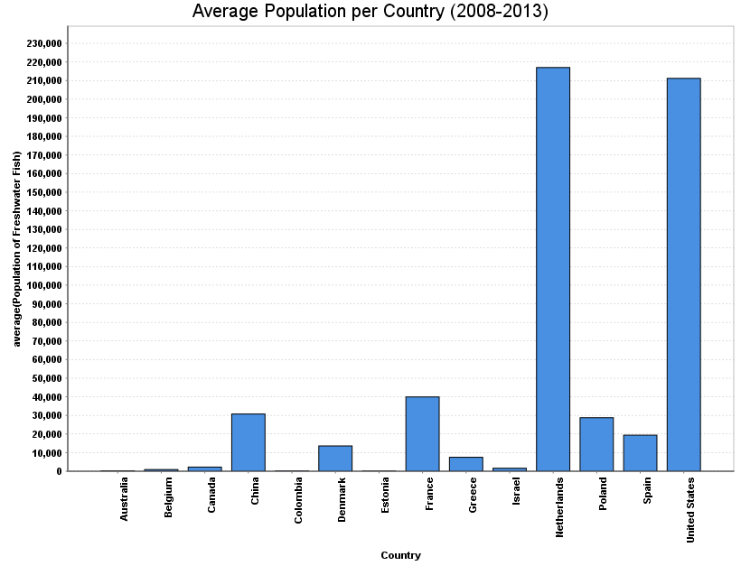
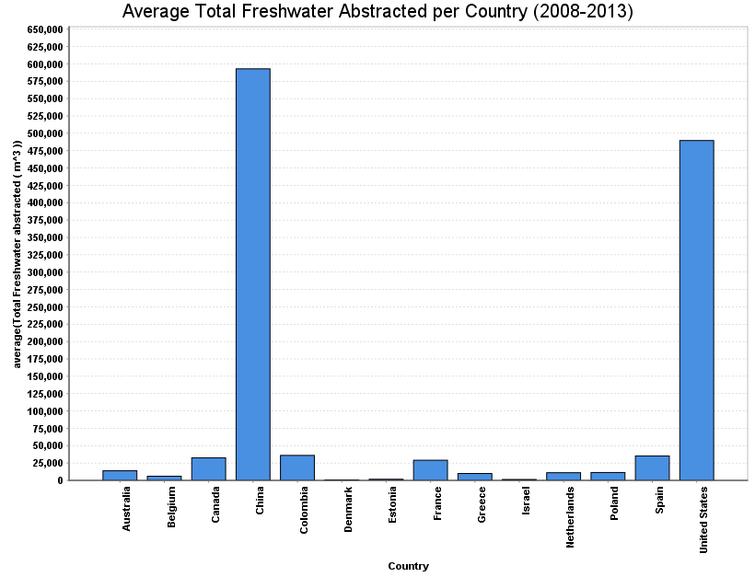
Freshwater pull affect on biodiveristy
The Netherlands & United States, has the highest population of Freshwater Fish.
Notes:
Taking two countries in one continent and compare them to each other and to the another continent seemed to us as relevant for our question.

Slide 15
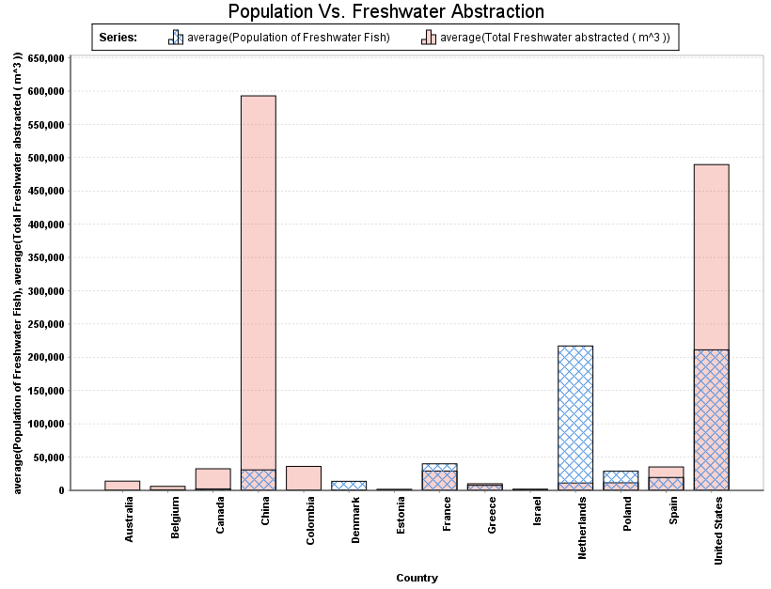
Freshwater pull affect on biodiveristy
As expected, after inspecting USA, China, and Netherlands.
The amount of freshwater abstraction is inversely proportional to the Quantity of water life forms.
China total Freshwater abstract is approx. 600,000 m^3, hence the fish population is barely 25,000.
The opposite is affect is shown with Netherlands, how the country has a low Freshwater abstraction rate, (~10^3), yielding a high Fish population of ~225,000.
Notes:
Taking two countries in one continent and compare them to each other and to the another continent seemed to us as relevant for our question.

Slide 16
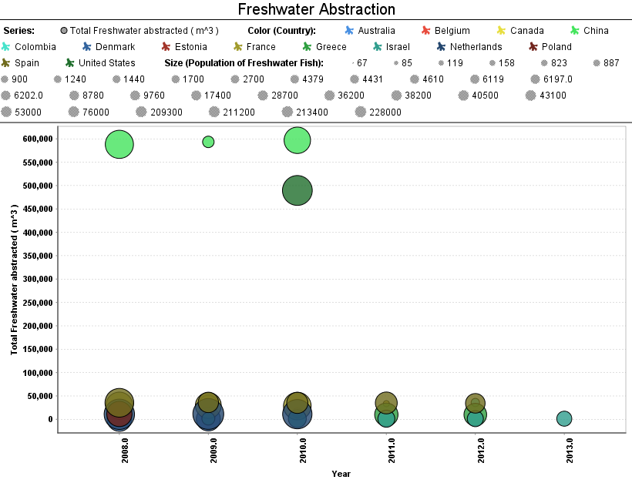
Freshwater pull affect on biodiveristy
The bubble scatter chart, shows how China dominates the other Countries, with its High Freshwater Abstraction rate.
Note* : China’s high Freshwater Abstraction rate is function of the industry, such as:
Manufacturing industry
Irrigation
Public Water Supply
Agriculture
Notes:
Taking two countries in one continent and compare them to each other and to the another continent seemed to us as relevant for our question.

Slide 17
Comparison of CO2 production and law enforcement
Over the past 20 years, both France and Austria have increased their environmental policy stringency and interestingly this correlates with a decrease in their production of CO2 emission.
This decrease doesn’t seems to be affected by the amount of taxes raised for environmental causes.
Notes:
Taking two countries in one continent and compare them to each other and to the another continent seemed to us as relevant for our question.

Slide 18
Comparison of CO2 production and law enforcement
Over the past 20 years, both the United States and Canada have also increased their environmental policy stringency BUT interestingly their outcomes are different. While the United Stated decreased their CO2 emission, the Canada’s emission remained stable or might have even increased.
Notes:
Taking two countries in one continent and compare them to each other and to the another continent seemed to us as relevant for our question.

Slide 19
Mean PM2.5 exposure
Over the past 15 years, both France and Austria have reduced their mean population exposure to PM2.5.
PM2.5 (atmospheric particulate matter (PM) that have a diameter of less than 2.5 micrometers) that can come from various sources (power plants, motor vehicles, airplanes, residential wood burning, forest fires, agricultural burning, volcanic eruptions and dust storms).
Notes:
Taking two countries in one continent and compare them to each other and to the another continent seemed to us as relevant for our question.

Slide 20
Mean PM2.5 exposure
Over the past 15 years, both the US and Canada have reduced their mean population PM2.5 exposure.
Notes:
Taking two countries in one continent and compare them to each other and to the another continent seemed to us as relevant for our question.

Slide 21
Observed conclusions
 | France | Austria | United States | Canada
Biodiversity | Increased | Increased | Increased | Decreased
CO2 emission | Decreased | Decreased | Decreased | Increased
Law enforcement | Increased | Increased | Increased | Increased
Mean pop exposure to PM2.5 | Decreased | Decreased | Decreased | Decreased
Can we make any correlations ?
Notes:
Taking two countries in one continent and compare them to each other and to the another continent seemed to us as relevant for our question.

Slide 22
Correlations
Environmental Policy Stringency
Biodiversity:
Positively correlates with the Environmental Policy Stringency for all countries except Canada. This is in good fit with our observations.
Mean Exposure to PM2.5:
Negatively correlates with Environmental Policy Stringency except for the United States. Could represent the fact that the US are producing a lot more CO2 than the other countries analyzed.
France
Austria
Canada
United States
Notes:
Taking two countries in one continent and compare them to each other and to the another continent seemed to us as relevant for our question.

Slide 23
Overall Correlations
Notes:
Taking two countries in one continent and compare them to each other and to the another continent seemed to us as relevant for our question.

Slide 24
Discussion
Discuss your findings. Did you find what you expected to find? If not, why not? What inferences or general conclusions can you draw from your analysis?
Question at hand: “ How much does the environmental policy of a country impact on its CO2 production, pollution or biodiversity? ”:
We found that strict enforcement of environmental policies does indeed correlate with a decrease in mean population exposure to PM2.5 in all countries tested, as well as a decrease in CO2 emissions.
Interestingly, the consequences of an increased budget allocated to environmental causes did not generally correlate with biodiversity or pollution numbers. This might be linked to the fact that an investment in R&D for example will only have a potential impact years after the investment.
Biodiversity data are harder to correlate to the governmental policies due to the fact that the impact of new laws are likely only going to be be seen years/decades later.
Biodiversity increases seen in some of the countries we analyzed could be more due to technological improvements to data collection methods (GPS, satellites imaging, etc) than to an actual growth of the population or improvement in biodiversity.
Pollution rates and environmental regulations/policies are only a few aspects of the complex web of what ultimately impacts biodiversity on a global scale.
All of the data we analyzed had to be reported by the countries themselves to some extent which could introduce biases that confound analyses (varying technologies/approaches used for measurements, etc)
Notes:
Taking two countries in one continent and compare them to each other and to the another continent seemed to us as relevant for our question.

Slide 25
Thank you !

Slide 26
Explanations
22 developed countries over the past decade saw GDP growth, while CO2 emissions have dropped significantly, mostly in Europe, but also the US. Canada is noticeably not on this list.
So what’s going on?
According to Environment and Climate Change Canada, part of the problem is that Canada has a wildly variable climate, with huge heating demands in the winter and, in populous central Canada, huge cooling demands in the summer, compared to other industrialized nations. Canada is vast and sparsely populated, leading to greater demand for transportation than more densely populated countries. As both heating and transport in much of Canada is largely fossil-fuel powered, we get hit more here as well.
Meanwhile, with most of our electricity already clean, a lot of the low-hanging fruit has already been picked. The US is able to report large CO2 declines due primarily to its widespread shift from coal to natural gas-powered electricity.
Source: http://theclimateexaminer.ca/2017/11/16/canadas-tasks-global-co2-emissions-3-year-hiatus/

